Slide 1
Recommendations on Opening a Korean Restaurant in Toronto
Yae Whan Lee

Slide 2
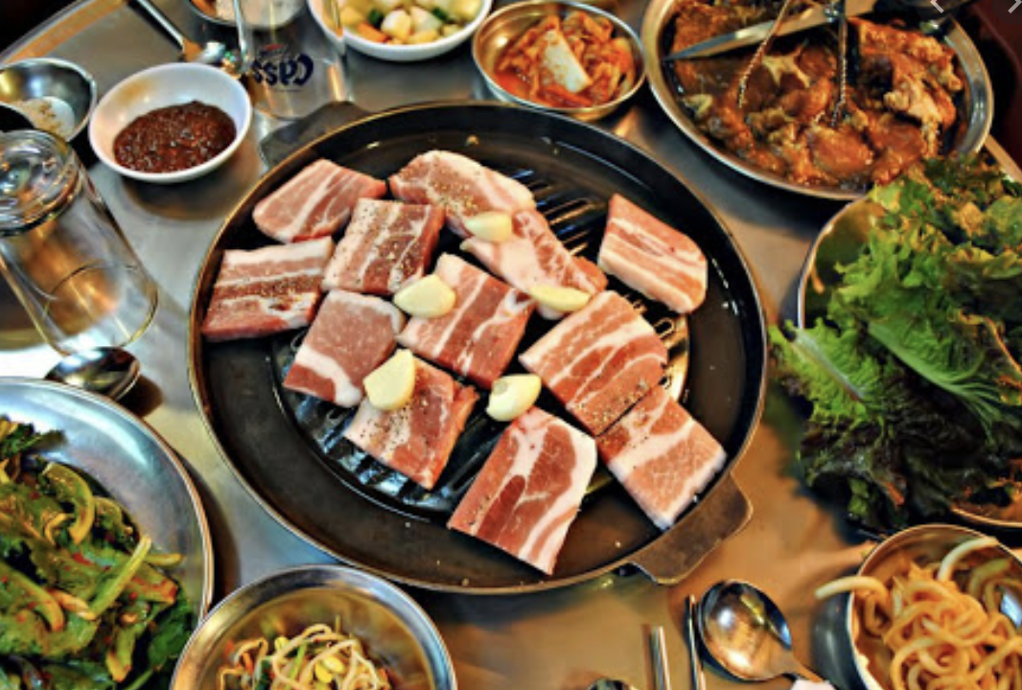
Introduction and Recommendation
Korean food has recently boomed due to the influence of K-pop and other forms of cultural power. For instance, Korean barbeque is now one of the most popular foods due to the spread of K-drama.
It is vital that newcomers of the Korean restaurant owners must strategize their location and the nearby competitions of the region

Slide 3

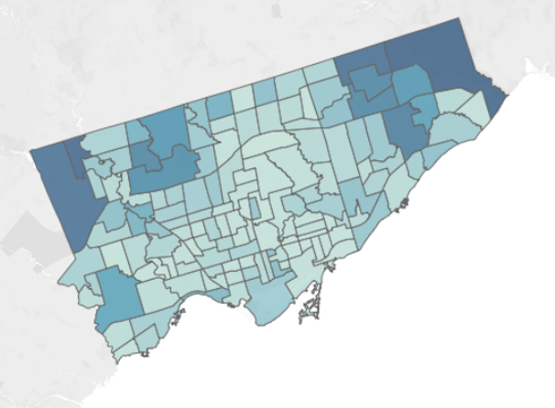
Identifying the Problem & Audience
Finding a suitable location for a restaurant is essential for a high revenue.
The audience would be limited to those who wishes to open a Korean restaurant within Toronto

Slide 4


Data and Methodology
In order to find the best location, I will be using sources which provide data on the neighborhood’s location and names, as well as the restaurants that could potentially threaten the uniqueness of the Korean restaurant. This can be done by gathering the list through online encyclopedias and using the Geocoder package, as well as the Foursquare API.

Slide 5
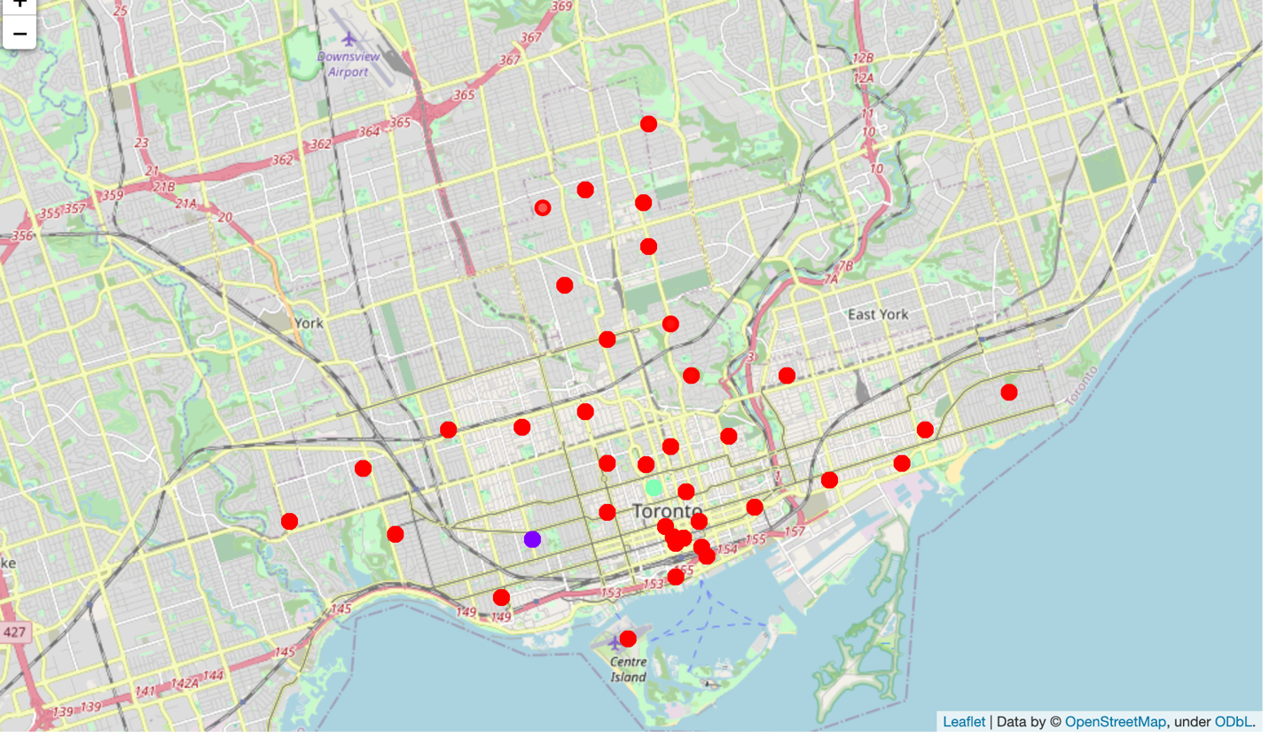
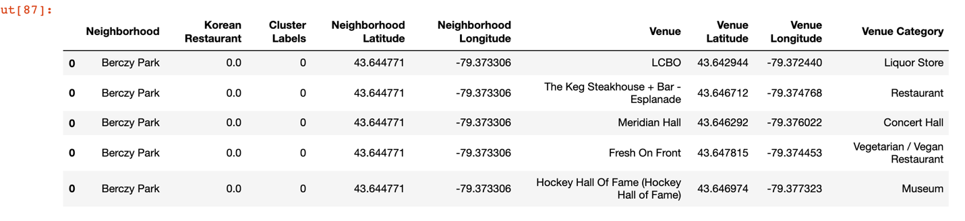
Results

Slide 6
Evaluation
In this case, we can see that cluster 0 and 1 had only one point meaning there are very little Korean restaurants in that region. Meanwhile, cluster 2 had an abundance of Korean restaurants which could mean that cluster 2 has a lower chance of success due to higher level of competition in the regions.
Therefore, the best areas to Richmond, Adelaide, King and Little Portugal, Trinity are the best places to open a Korean restaurant. Low numbers of competitors could mean that people have limited options when going to a unique place. Higher price and popularity could also follow through.

Slide 7
Conclusion
Overall, this project could ultimately benefit those who are willing to open a Korean restaurant in Toronto.
Thank you!

